Slide 1





















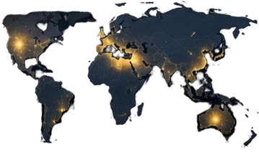















WEEKLY PERFORMANCE
TRANSACTIONS
CUSTOMERS
+28.8%
REVENUE
GROWTH
57M
667.2K
CREDIT CARD
WEEKLY ANALYTICS DASHBOARD
CUSTOMER ANALYTICS
PREMIUM
Active Customers
124K
REVENUE TREND
CREDIT CARD
New Customers
18.6K
Retention Rate
78%
End-to-End Data Analytics Project using PostgreSQL & Power BI
4532 3100 8888 8888
CARD CATEGORY
VALID
12/28
Platinum
TRANSACTION VOLUME
12/28
VISA
Gold
Classic
Presented by Krity Pandey | Data Analyst
Business
GEOGRAPHIC INSIGHTS
High
CSV
POSTGRESQL
SQL
POWER BI
DAX
Low

Slide 2



























BUSINESS
PROBLEM & PROJECT OBJECTIVE
BUSINESS CHALLENGE
RAW DATA
BUSINESS INSIGHTS
PROJECT OBJECTIVE
Credit card businesses generate large volumes of transaction and customer data. Without proper analytics, it becomes difficult to monitor performance, understand customer behaviour, and identify business trends.
Build a refreshing Credit Card Analytics Dashboard that transforms raw transaction data into actionable business insights.
Revenue performance tracking
Monitor weekly performance
Customer behaviour analysis
Analyze customer segments
Transaction trend monitoring
Track revenue growth
Card category performance
Identify business trends
Risk and engagement monitoring
Support data-driven decisions

Slide 3
































END-TO-END
DATA WORKFLOW
From Raw Data to Interactive Insights
STEP
STEP
STEP
STEP
1
2
3
4
CSV
RAW TRANSACTION DATA
POSTGRESQL DATABASE
SQL DATA PROCESSING
INTERACTIVE DASHBOARD
Transaction data
Create database tables
Data validation
KPI monitoring
Customer data
Import CSV files
Data cleaning
Business insights
Card details
Store structured data
Create analytical metrics
Weekly performance tracking
CLEAN DATA
STRUCTURED PROCESS
ACTIONABLE INSIGHTS
→ RELIABLE ANALYSIS
→ EFFICIENT WORKFLOW
→ BETTER DECISIONS

Slide 4





































DATA PREPARATION &
SQL PROCESS
Transforming Raw_CSV Data into Analytics-Ready Data
STAGE
STAGE
STAGE
STAGE
1
2
3
4
CSV
CSV
CSV DATA PREPARATION
DATABASE CREATION
DATA IMPORT
DATA VALIDATION
Prepared transaction dataset
Created PostgreSQL tables
Loaded CSV files into PostgreSQL
Verified records
Prepared customer dataset
Structured raw data
Used SQL COPY command
Checked data consistency
Checked data structure
Prepared database environment
Imported data successfully
Prepared data for Power BI analysis
CSV FILES
POSTGRESQL TABLES
SQL VALIDATION
ANALYTICS READY DATA
TOOLS USED
CSV | POSTGRESQL | SQL

Slide 5
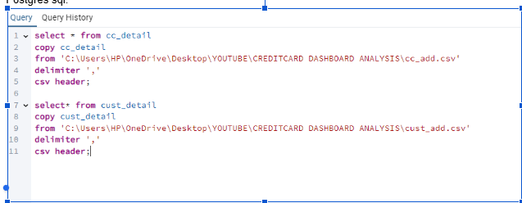
POSTGRESQL DATA IMPORT &
DATA WORKFLOW
Importing Customer and Transaction CSV Data into Structured Database Tables

Slide 6

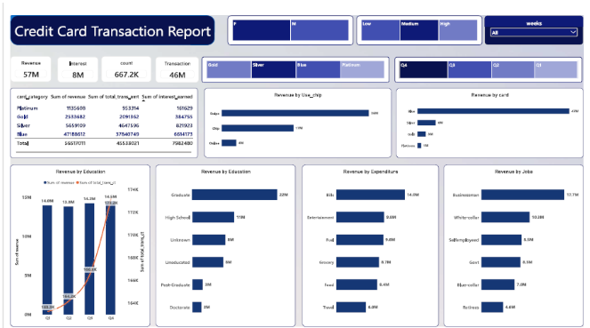





CREDIT CARD TRANSACTION ANALYSIS
DASHBOARD
Analyzing Revenue, Transaction Performance & Spending Patterns
Analysis Areas
Transaction Performance
  Revenue Analysis
  Transaction analysis
Card Catogory Performance
  Gold,Silver,Blue,Platinum
Payment Channel Analysis
  Swipe, Online, Chip
Expenditure Analysis
  Category wise spending
Expenditure Analysis
Job Catogory Analysis
  Customer Wise Analysis

Slide 7
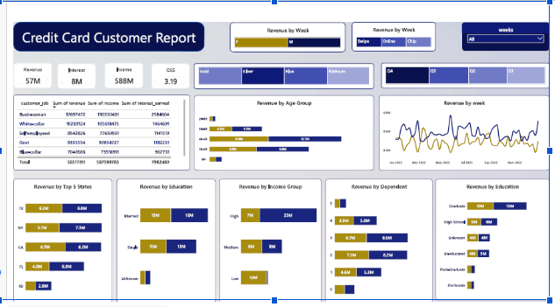




DASHBOARD
CUSTOMER ANALYTICS
Analyzing Customer Segments, Behaviour & Revenue Contribution
Analysis Areas
Customer Segmentation
  Gender Analysis
  Age Group Analysis
  Income Group Analysis
Customer Profile Analysis
  Occupation Analysis
  Education Analysis
Geographical area analysis
  State-wise Revenue Analysis
Trend Analysis
  Weekly Revenue Performance
Expenditure Analysis
Purpose
Understand customer behaviour and identify key segments contributing to business revenue.

Slide 8
PROJECT INSIGHTS –
WEEK 53 (31ST DEC)
Weekly Performance Highlights
WoW change
  Revenue increased by 28.8%
  Total Transaction amount and count increased by 35.36% and 3.39%
  Customer count increased by12.8%
Year to Date change
  Overall Revenue is 57M
  Total Interest is 8M
  Total Transaction Amount is 46M
  Male Customers are Contributing more revenue 31M and Female revenue 26M
  Blue and Silver credit card generating more revenue 93% Overall transactions
  TX,NY & CA contributing to 68%
  Overall Activation Rate is 57.5%
  Overall Delinquent rate is 6.06%

Slide 9
